Slide 1


International Economics: Theory and Policy
Twelfth Edition
Chapter 15
Money, Interest Rates, and Exchange Rates
Copyright © 2022, 2018, 2015 Pearson Education, Inc. All Rights Reserved
Notes:
If this PowerPoint presentation contains mathematical equations, you may need to check that your computer has the following installed:
1) MathType Plugin
2) Math Player (free versions available)
3) NVDA Reader (free versions available)

Slide 2
Learning Objectives
15.1 Describe and discuss the national money markets in which interest rates are determined.
15.2 Show how monetary policy and interest rates feed into the foreign exchange market.
15.3 Distinguish between the economy’s long-run position and the short run, in which money prices and wages are sticky.
15.4 Explain how price levels and exchange rates respond to monetary factors in the long run.
15.5 Outline the relationship between the short-run and the long-run effects of monetary policy, and explain the concept of short-run exchange rate overshooting.

Slide 3
Preview
What is money?
Control of the supply of money
The willingness to hold monetary assets
A model of real monetary assets and interest rates
A model of real monetary assets, interest rates, and exchange rates
Long-run effects of changes in money on prices, interest rates, and exchange rates

Slide 4
What Is Money? (1 of 3)
Money is an asset that is widely used as a means of payment.
Different groups of assets may be classified as money.
Money can be defined narrowly or broadly.
Currency in circulation, checking deposits, and debit card accounts form a narrow definition of money.
Deposits of currency are excluded from this narrow definition, although they may act as a substitute for money in a broader definition.

Slide 5
What Is Money? (2 of 3)
Money is a liquid asset: it can be easily used to pay for goods and services or to repay debt without substantial transaction costs.
But monetary or liquid assets earn little or no interest.
Illiquid assets require substantial transaction costs in terms of time, effort, or fees to convert them to funds for payment.
But they generally earn a higher interest rate or rate of return than monetary assets.

Slide 6
What Is Money? (3 of 3)
Let’s group assets into monetary assets (or liquid assets) and non-monetary assets (or illiquid assets).
The demarcation between the two is arbitrary,
but currency in circulation, checking deposits, debit card accounts, savings deposits, and time deposits are generally more liquid than bonds, loans, deposits of currency in the foreign exchange markets, stocks, real estate, and other assets.

Slide 7
Money Supply
The central bank substantially controls the quantity of money that circulates in an economy, the money supply.
In the United States, the central banking system is the Federal Reserve System.
The Federal Reserve System directly regulates the amount of currency in circulation.
It indirectly influences the amount of checking deposits, debit card accounts, and other monetary assets.

Slide 8
Money Demand
Money demand represents the amount of monetary assets that people are willing to hold (instead of illiquid assets).
What influences willingness to hold monetary assets?
We consider individual demand of money and aggregate demand of money.

Slide 9
What Influences Demand of Money for Individuals and Institutions?
Interest rates/expected rates of return on monetary assets relative to the expected rates of returns on non-monetary assets.
Risk: the risk of holding monetary assets principally comes from unexpected inflation, which reduces the purchasing power of money.
But many other assets have this risk too, so this risk is not very important in defining the demand of monetary assets versus non-monetary assets.
Liquidity: A need for greater liquidity occurs when the price of transactions increases or the quantity of goods bought in transactions increases.

Slide 10
What Influences Aggregate Demand of Money? (1 of 2)
Interest rates/expected rates of return: monetary assets pay little or no interest, so the interest rate on non-monetary assets such as bonds, loans, and deposits is the opportunity cost of holding monetary assets.
A higher interest rate means a higher opportunity cost of holding
monetary assets
lower demand of money.
Prices: the prices of goods and services bought in transactions will influence the willingness to hold money to conduct those transactions.
A higher level of average prices means a greater need for liquidity to buy the same amount of goods and services
higher demand of money.

Slide 11
What Influences Aggregate Demand of Money? (2 of 2)
Income: greater income implies more goods and services can be bought, so that more money is needed to conduct transactions.
A higher real national income (G N P) means more
goods and services are being produced and bought in
transactions, increasing the need for liquidity
higher demand of money.

Slide 12
A Model of Aggregate Money Demand
The aggregate demand of money can be expressed as:
where:
P is the price level
Y is real national income
R is a measure of interest rates on non-monetary assets
is the aggregate demand of real monetary assets
Aggregate demand of real monetary assets is a function of national income and interest rates.

Slide 13
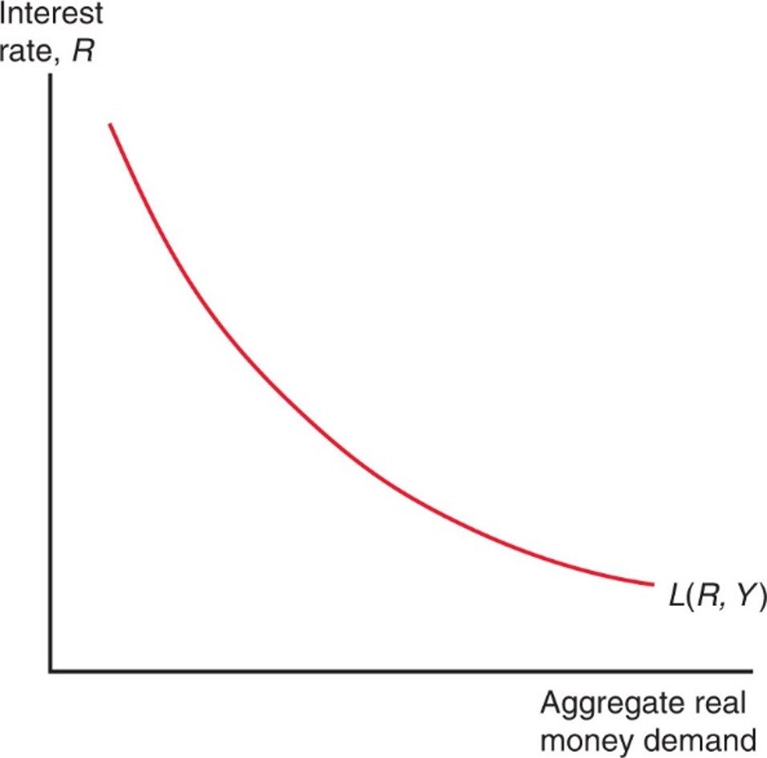
Figure 15.1 Aggregate Real Money Demand and the Interest Rate
The downward-sloping real money demand schedule shows that for a given real income level Y, real money demand rises as the interest rate falls.

Slide 14
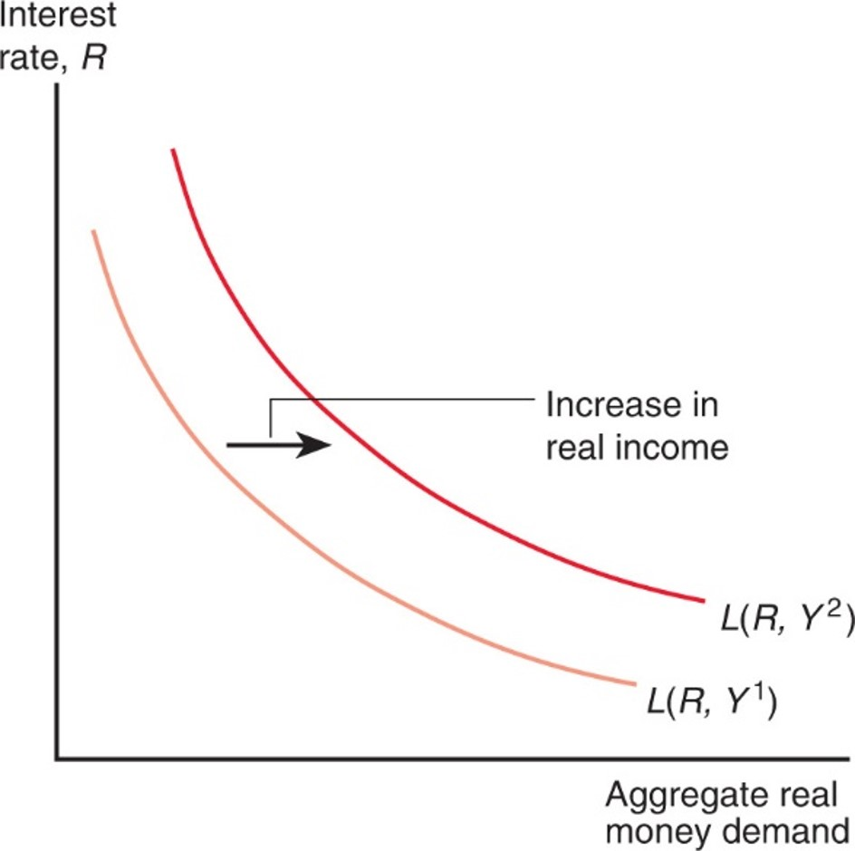
Figure 15.2 Effect on the Aggregate Real Money Demand Schedule of a Rise in Real Income
An increase in real income from
raises the demand for real
money balances at every level of the interest rate and causes the whole demand schedule to shift upward.
Notes:
The plot for L left parenthesis R, Y super 1 right parenthesis, is shifted to the right, for an increase in real income: L left parenthesis, R, Y super 2, right parenthesis.

Slide 15
A Model of the Money Market (1 of 4)
The money market is where monetary or liquid assets, which are loosely called “money,” are lent and borrowed.
Monetary assets in the money market generally have low interest rates compared to interest rates on bonds, loans, and deposits of currency in the foreign exchange markets.
Domestic interest rates directly affect rates of return on domestic currency deposits in the foreign exchange markets.

Slide 16
A Model of the Money Market (2 of 4)
When no shortages (excess demand) or surpluses (excess supply) of monetary assets exist, the model achieves an equilibrium:
Alternatively, when the quantity of real monetary assets supplied matches the quantity of real monetary assets demanded, the model achieves an equilibrium:

Slide 17
A Model of the Money Market (3 of 4)
When there is an excess supply of monetary assets, there is an excess demand for interest-bearing assets such as bonds, loans, and deposits.
People with an excess supply of monetary assets are willing to offer or accept interest-bearing assets (by giving up their money) at lower interest rates.
Others are more willing to hold additional monetary assets as interest rates (the opportunity cost of holding monetary assets) fall.

Slide 18
A Model of the Money Market (4 of 4)
When there is an excess demand of monetary assets, there is an excess supply of interest-bearing assets such as bonds, loans, and deposits.
People who desire monetary assets but do not have access to them are willing to sell non-monetary assets in return for the monetary assets that they desire.
Those with monetary assets are more willing to give them up in return for interest-bearing assets as interest rates (the opportunity cost of holding money) rise.

Slide 19
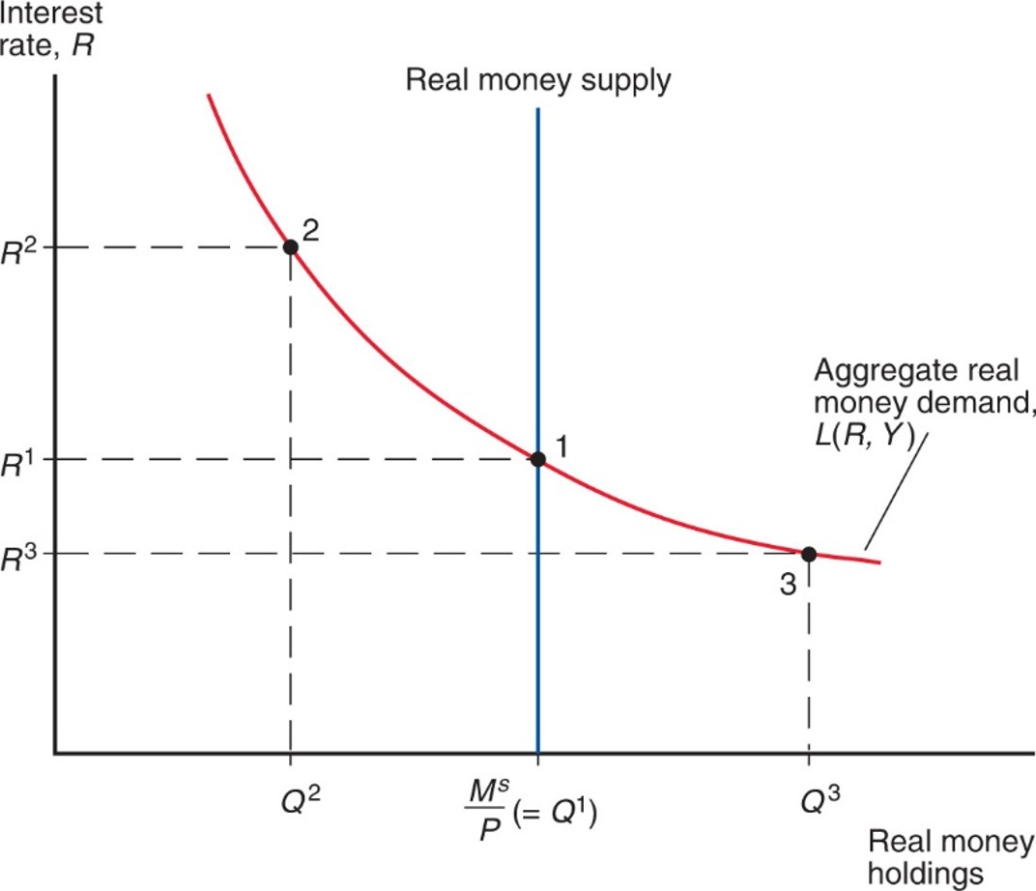
Figure 15.3 Determination of the Equilibrium Interest Rate
With P and Y given and a real money supply of
money market
equilibrium is at point 1. At this point, aggregate real money demand and
the real money supply are equal and the equilibrium interest rate is
Notes:
The aggregate real money demand curve, L left parenthesis R, Y right parenthesis, falls with decreasing steepness through 3 points, from left to right: point 2 (Q super 2, R super 2); the real money supply, (Q super 1, R super 1) and (Q super 3, R super 3). For real money supply, M super s, over P, left parenthesis = Q super 1, right parenthesis.

Slide 20
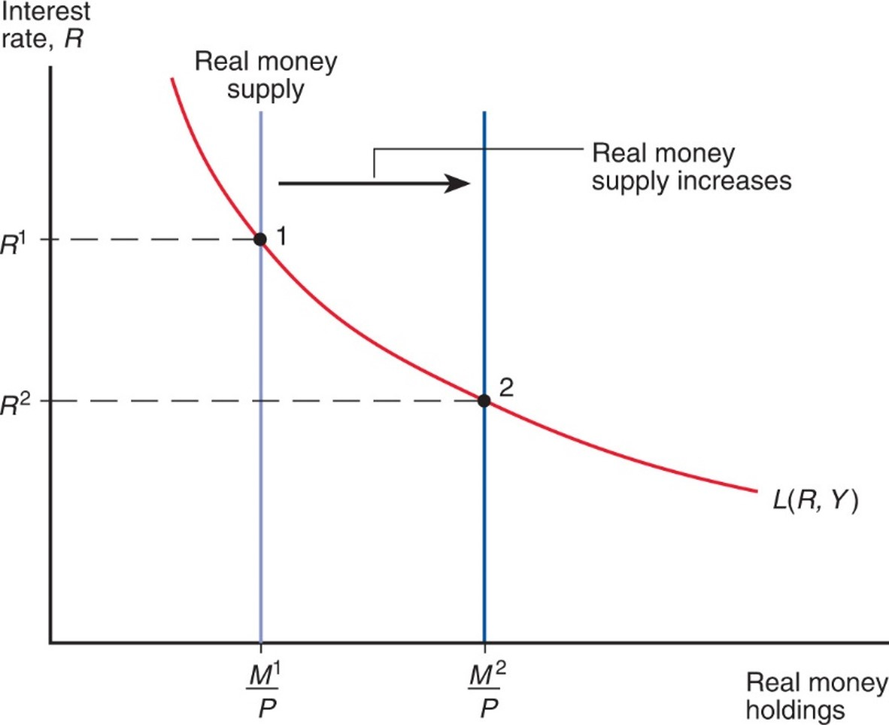
Figure 15.4 Effect of an Increase in the Money Supply on the Interest Rate
For a given price level, P, and real income level, Y, an increase in
the money supply from
reduces the interest rate from
Notes:
The plot for L left parenthesis, R, Y, right parenthesis, falls with decreasing steepness through point 1 at (M super 1 over P, R super 1) and the point 2 at (M super 2, over P, R super 2). When the vertical line of the real money supply increases, and shifts to the right, point 2 becomes the new lower interest rate.

Slide 21
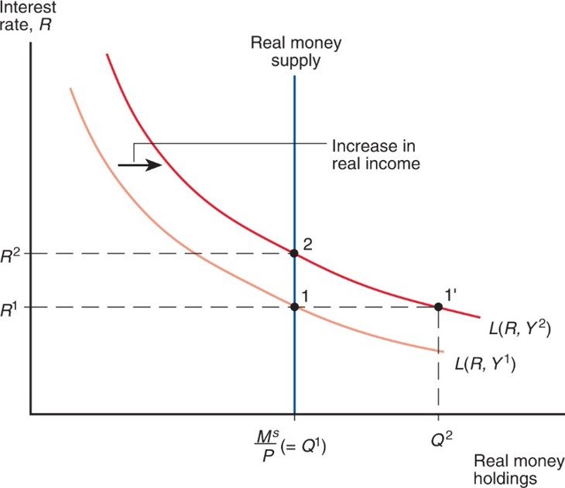
Figure 15.5 Effect on the Interest Rate of a Rise in Real Income
Given the real money supply,
a rise in real income from
reduces the interest rate from
Notes:
The plot for L left parenthesis, R, Y super 1, right parenthesis, falls through point 1 at (Q super 1, R super 1). The aggregate real money demand curve shifts to the right when there is an increase in real income, for plot L left parenthesis, R, Y super 2, right parenthesis. Point 1 shifts to the right to point 1 prime at (Q super 2, R super 1). Point 2 is then above point 1 at (Q super 1, R super 2), on the vertical line for real money supply.

Slide 22
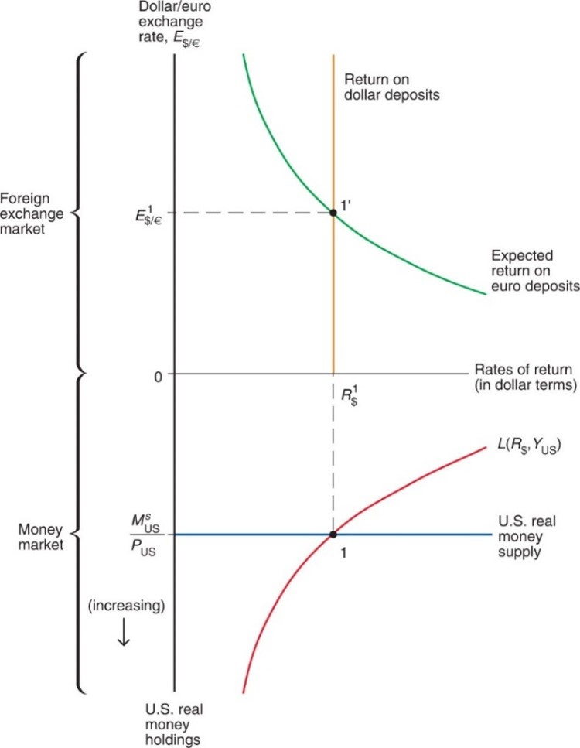
Figure 15.6 Simultaneous Equilibrium in the U.S. Money Market and the Foreign Exchange Market
Both asset markets are in equilibrium at the interest rate
and exchange rate
at these values, money supply equals money
demand (point 1) and the interest parity condition holds (point 1’).
Notes:
Above y = 0, the y-axis represents the dollar to euro exchange rate. The expected return on euro deposits on this upper half of the graph falls with decreasing steepness through point 1 prime, at (R sub dollars super 1, E sub dollars to euros, super 1). Below y = 0, the y-axis represents U S real money holdings, which increases in a downward direction. The plot for L left parenthesis R sub dollars, Y sub U S, right parenthesis, rises with decreasing steepness through point 1, where x = R sub dollars super 1, and y = the U S real money supply, which is M sub U S super S, over, P sub U S.

Slide 23
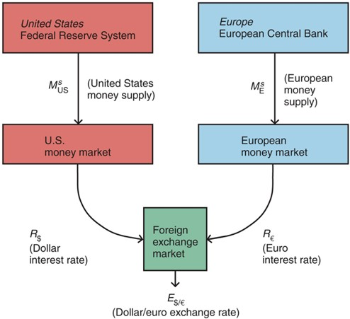
Figure 15.7 Money Market/Exchange Rate Linkages
Monetary policy actions by the Fed affect the U.S. interest rate, changing the dollar/euro exchange rate that clears the foreign exchange market. The E C B can affect the exchange rate by changing the European money supply and interest rate.
Notes:
In the United States, the Federal Reserve System determines the U S money supply through the U S money market, determining the dollar interest rate. In Europe, the European Central Bank monitors the European money supply of that money market to determine the euro interest rate. Together, these forces determine the foreign exchange market, dollar to euro exchange rate.

Slide 24
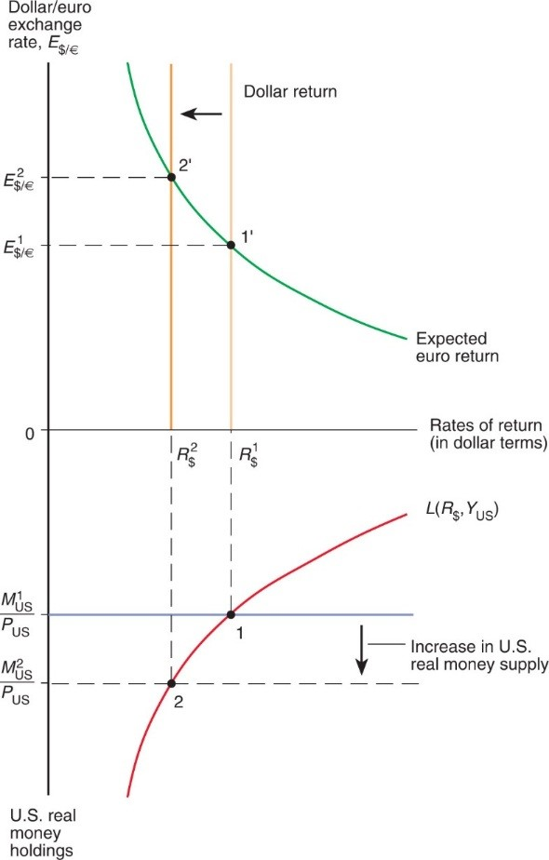
Figure 15.8 Effect on the Dollar/Euro Exchange Rate and Dollar Interest Rate of an Increase in the U.S. Money Supply
Given
when the money supply rises from
the dollar interest rate declines (as money market equilibrium is reestablished at point 2) and the dollar depreciates against the euro (as foreign exchange market equilibrium is reestablished at point 2’).
Notes:
Above y = 0, the plot for expected euro return falls with decreasing steepness through point 2 prime, at (R sub dollars super 2, E sub dollars to euros super 2), and then point 1 prime at (R sub dollars super 1, E sub dollars to euros, super 1). Below y = 0, the plot for L left parenthesis, R sub dollars, Y sub U S, right parenthesis, rises with decreasing steepness through point 2 and then point 1. Point 2 is located at (R sub dollars super 2, M sub U S super 2 over P sub U S), and point 1 is located at (R sub dollars super 1, M sub U S super 1 over P sub U S). The vertical distance between point 1 and point 2 represents an increase in U S real money supply.

Slide 25
Changes in the Domestic Money Supply
An increase in a country’s money supply causes interest rates to fall, rates of return on domestic currency deposits to fall, and the domestic currency to depreciate.
A decrease in a country’s money supply causes interest rates to rise, rates of return on domestic currency deposits to rise, and the domestic currency to appreciate.

Slide 26
Changes in the Foreign Money Supply (1 of 2)
How would a change in the supply of euros affect the U.S. money market and foreign exchange markets?
An increase in the supply of euros causes a depreciation of the euro (an appreciation of the dollar).
A decrease in the supply of euros causes an appreciation of the euro (a depreciation of the dollar).

Slide 27
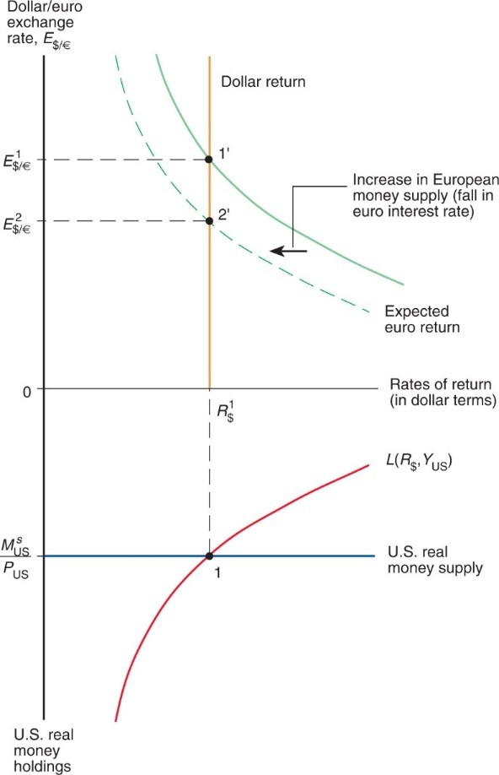
Figure 15.9 Effect of an Increase in the European Money Supply on the Dollar/Euro Exchange Rate
By lowering the dollar return on euro deposits (shown as a leftward shift in the expected euro return curve), an increase in Europe’s money supply causes the dollar to appreciate against the euro. Equilibrium in the foreign exchange market shifts from point 1’ to point 2’ but equilibrium in the U.S. money market remains at point 1.
Notes:
Above y = 0, the original plot falls with decreasing steepness through point 1 prime, at (R sub dollars super 1, E sub dollars to euros, super 1). The plot is then shifted right for an increase in European money supply, or fall in euro interest rate, for the new expected euro return. The dashed-line plot falls with decreasing steepness through point 2 prime, (R sub dollars super 1, E sub dollars to euros super 2), which is below point 1 prime. Below y = 0, the plot for L left parenthesis R sub dollars, Y sub U S, right parenthesis, rises with decreasing steepness through point 1, at (R sub dollars super 1, U S real money supply).

Slide 28
Changes in the Foreign Money Supply (2 of 2)
The increase in the supply of euros reduces interest rates in the E U, reducing the expected rate of return on euro deposits.
This reduction in the expected rate of return on euro deposits causes the euro to depreciate.
We predict no change in the U.S. money market due to the change in the supply of euros.

Slide 29
Long Run and Short Run (1 of 3)
In the short run, prices do not have sufficient time to adjust to market conditions.
The analysis heretofore has been a short-run analysis.
In the long run, prices of factors of production and of output have sufficient time to adjust to market conditions.
Wages adjust to the demand and supply of labor.
Real output and income are determined by the amount of workers and other factors of production—by the economy’s productive capacity—not by the quantity of money supplied.
(Real) interest rates depend on the supply of saved funds and the demand of saved funds.

Slide 30
Long Run and Short Run (2 of 3)
In the long run, the quantity of money supplied is predicted not to influence the amount of output, (real) interest rates, and the
aggregate demand of real monetary assets
However, the quantity of money supplied is predicted to make the level of average prices adjust proportionally in the long run.
The equilibrium condition
shows that
P is predicted to adjust proportionally when
adjusts, because
does not change.

Slide 31
Long Run and Short Run (3 of 3)
In the long run, there is a direct relationship between the inflation rate and changes in the money supply.
The inflation rate is predicted to equal the growth rate in money supply minus the growth rate in money demand.

Slide 32
Empirical Evidence on Money Supplies and Price Levels (1 of 2)
Expect positive association between money supplies and price levels in the data, although the relation will not be exact.
Figure 15-10 shows that, on average, years with higher money growth also tended to be years with higher inflation.
Money supplies and price levels appear to increase in proportion.
Data confirm the strong long-run link between national money supplies and national price levels predicted by economic theory.

Slide 33
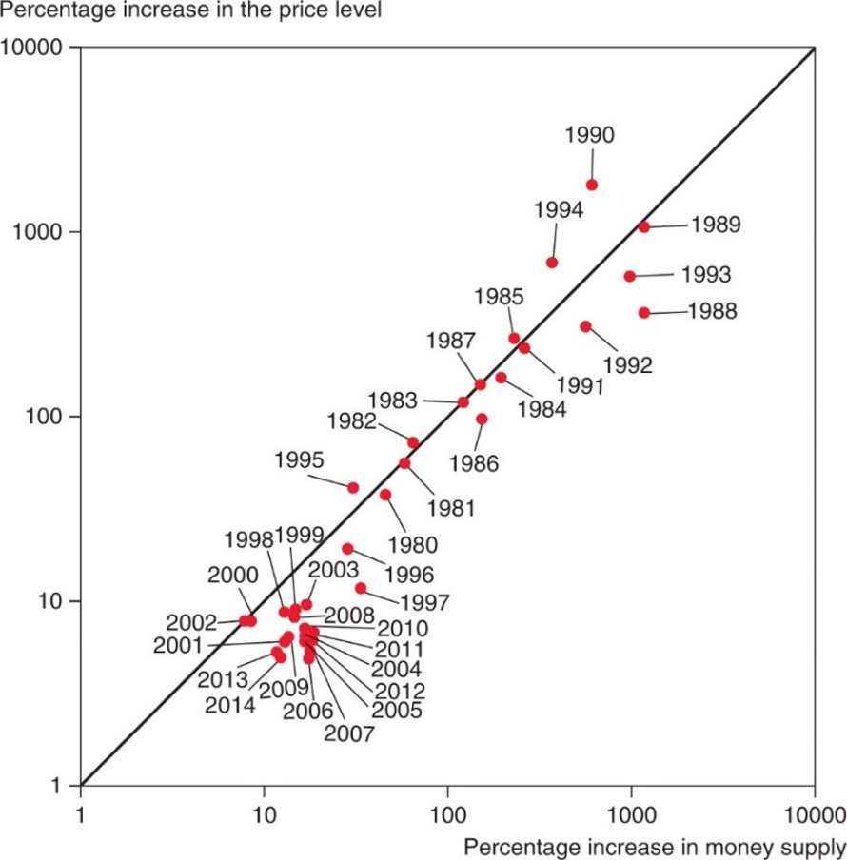
Figure 15.10 Average Money Growth and Inflation in Western Hemisphere Developing Countries, by Year, 1987–2014
Even year by year, there is a strong positive relation between average Latin American money supply growth and inflation. (Both axes have logarithmic scales.)
Source: World Bank development indicators database and own calculations. Regional aggregates are weighted by shares of dollar G D P in total regional dollar G D P.
Notes:
A 45-degree rising line passes through the data. Dots are clusters slightly below the line at roughly (20, 9) for years including 1998, 1999 and 2003 to 2014. Midway up the line, at (100, 100) are years including 1982 to 1987. At (1000, 1000), years include 1989, 1990, 1993 and 1994, farther apart than earlier points. All values estimated.

Slide 34
Empirical Evidence on Money Supplies and Price Levels (2 of 2)
Venezuela experienced exceptionally high levels of money supply growth and inflation in the later 2010s, as depicted in Figure 15-11.
Zimbabwe 2007–2009 is another case of recent hyperinflation, explosive and seemingly uncontrollable inflation in which money loses value rapidly and may even go out of use.

Slide 35
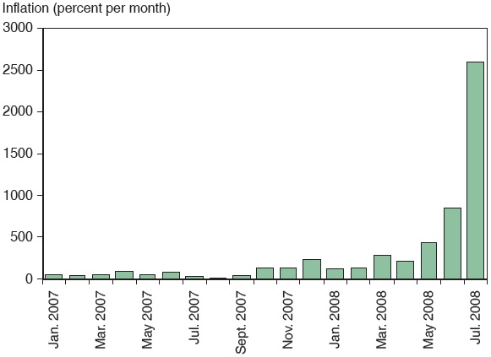
Monthly Inflation in Zimbabwe 2007–2008
Source: Reserve Bank of Zimbabwe..
Notes:
From January to September 2007, inflation holds at roughly 80 percent. In December 2007, inflation begins to rise to 250, to 800 in June 2008, and then in July 2008 to 2,750 percent. All values are estimated.

Slide 36
Money and Prices in the Long Run (1 of 2)
How does a change in the money supply cause prices of output and inputs to change?
Excess demand of goods and services: a higher quantity of money supplied implies that people have more funds available to pay for goods and services.
To meet high demand, producers hire more workers, creating a strong demand of labor services, or make existing employees work harder.
Wages rise to attract more workers or to compensate workers for overtime.
Prices of output will eventually rise to compensate for higher costs.

Slide 37
Money and Prices in the Long Run (2 of 2)
Alternatively, for a fixed amount of output and inputs, producers can charge higher prices and still sell all of their output due to the high demand.
Inflationary expectations:
If workers expect future prices to rise due to an expected money supply increase, they will want to be compensated.
And if producers expect the same, they are more willing to raise wages.
Producers will be able to match higher costs if they expect to raise prices.
Result: expectations about inflation caused by an expected increase in the money supply causes actual inflation.

Slide 38
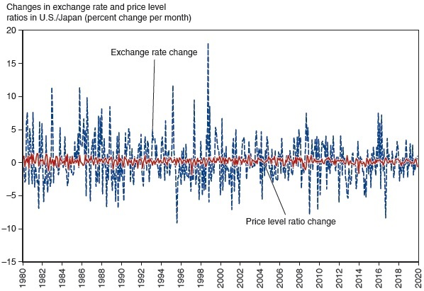
Figure 15.12 Month-to-Month Variability of the Dollar/Yen Exchange Rate and of the U.S./Japan Price Level Ratio, 1980–2019
The much greater month-to-month variability of the exchange rate suggests that price levels are relatively sticky in the short run.
Source: Price levels from International Monetary Fund, International Financial Statistics. Exchange rate from Global Financial Data.
Notes:
A double line graph plots the changes in the exchange rate and price level ratio for U S and Japan in percent change per month versus year, 19 80 to 20 20. The price level ratio change varies between y = 1 and y = negative 1 for the entire time frame. The exchange rate fluctuates between y = 10 and y = negative 5 with two significant spikes in 19 92 to 15 and 19 99 to 18 and a significant dip to negative 10 in 19 96. All values are estimated.

Slide 39
Money, Prices, Exchange Rates, and Expectations
When we consider price changes in the long run, inflationary expectations will have an effect in foreign exchange markets.
Suppose that expectations about inflation change as people change their minds, but actual adjustment of prices occurs afterward.

Slide 40
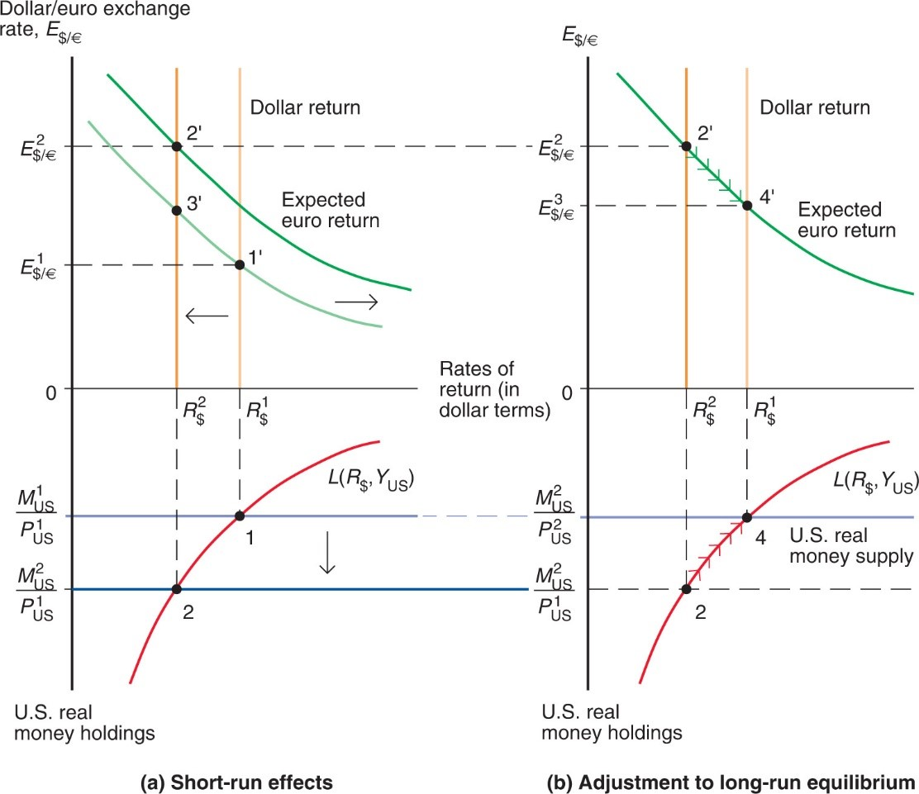
Figure 15.13 Short-Run and Long-Run Effects of an Increase in the U.S. Money Supply (Given Real Output, Y)
(a) Short-run adjustment of the asset markets. (b) How the interest rate, price level, and exchange rate move over time as the economy approaches its long-run equilibrium.
Notes:
Both graphs show the dollar to euro exchange rate above y = 0, and U S real money holding below y = 0, versus rates of return in dollar terms. In graph ay, short-run effects, the original plot for expected euro return falls with decreasing steepness through point 3 prime at x = R sub dollars super 2, and then point 1 prime, at (R sub dollars super 1, E sub dollars to euros super 1). The plot shifts to the right, and falls with decreasing steepness through point 2 prime, at (R sub dollars super 2, E sub dollars to euros super 2); the area above y = E sub dollars to euros super 2 is labeled, dollar return. The plot below y = 0 for L left parenthesis R sub dollars, Y sub U S, right parenthesis, rises with decreasing steepness through point 2 and point 1. Point 1 is at a horizontal line from y = M sub U S super 1 over P sub U S super 1. A decrease takes the horizontal line to point 2 at y = M sub U S super 2 over P sub U S super 1. In graph b, adjustment to long-run equilibrium the plot for expected euro exchange rate falls through point 2 prime at (R sub dollars super 2, E sub dollars to euros super 2), and then point 4 prime, at (R sub dollars super 1, E sub dollars to euros super 3). The plot for L left parenthesis R sub dollars, Y sub U S, right parenthesis, rises through point 2 at (R sub dollars super 2, M sub U S super 2 over P sub U S super 1), and then point 4, at (R sub dollars super 1, M sub U S super 2, P sub U S super 2). The horizontal at point 4 represents U S real money supply.

Slide 41
Money, Prices, and Exchange Rates in the Long Run
A permanent increase in a country’s money supply causes a proportional long-run depreciation of its currency.
However, the dynamics of the model predict a large depreciation first and a smaller subsequent appreciation.
A permanent decrease in a country’s money supply causes a proportional long-run appreciation of its currency.
However, the dynamics of the model predict a large appreciation first and a smaller subsequent depreciation.

Slide 42
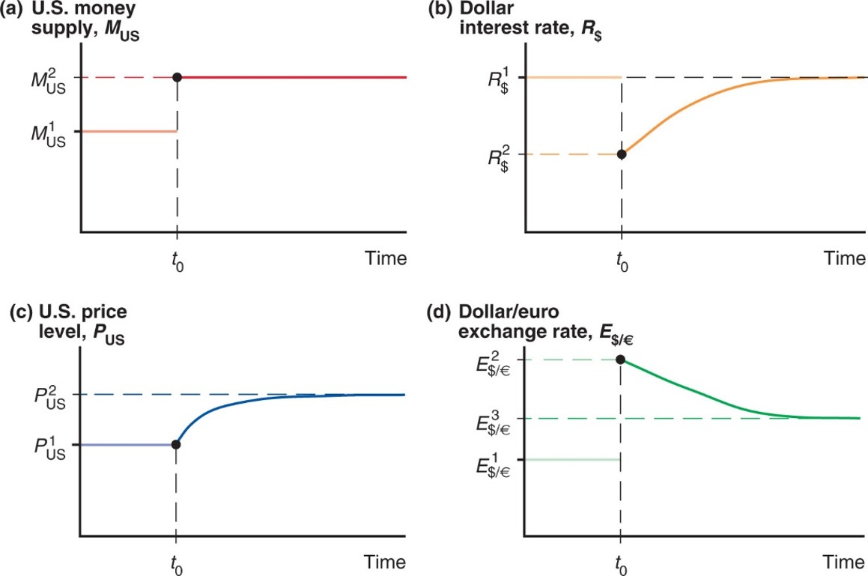
Figure 15.14 Time Paths of U.S. Economic Variables After a Permanent Increase in the U.S. Money Supply
After the money supply increases at
in panel (a), the interest rate [in panel
(b)], price level [in panel (c)], and exchange rate [in panel (d)] move as shown toward their long-run levels. As indicated in panel (d) by the initial jump from
the exchange rate overshoots in the short run before
settling down to its long-run level,
Notes:
The plot forms a horizontal line at y = M sub U S super 1, that extends to t sub 0, and then shifts upwards to M sub U S super 2. Graph b plots dollar interest rate, R sub dollars, versus time. The plot rises from R super 2 at t sub 0, with decreasing to steepness to R sub dollars super 1. Graph c plots U S price level, P sub U S, versus time. The plot begins as a horizontal line at y = P sub U S super 1, the rises with decreasing steepness to y = P sub U S super 2. Graph d plots dollar to euro exchange rate, E sub dollars to euros, versus time. The plot falls from y = E sub dollars to euros super 2 with decreasing steepness to y = E sub dollars to euros super 3, which is roughly midway between y = E sub dollars to euros super 2 and y = E sub dollars to euros super 1.

Slide 43
Exchange Rate Overshooting
The exchange rate is said to overshoot when its immediate response to a change is greater than its long-run response.
Overshooting is predicted to occur when monetary policy has an immediate effect on interest rates, but not on prices and (expected) inflation.
Overshooting helps explain why exchange rates are so volatile.

Slide 44
Summary (1 of 4)
Money demand for individuals and institutions is primarily determined by interest rates and the need for liquidity, the latter of which is influenced by prices and income.
Aggregate money demand is primarily determined by interest rates, the level of average prices, and national income.
Aggregate demand of real monetary assets depends negatively on the interest rate and positively on real national income.

Slide 45
Summary (2 of 4)
When the money market is in equilibrium, there are no surpluses or shortages of monetary assets: the quantity of real monetary assets supplied matches the quantity of real monetary assets demanded.
Short-run scenario: changes in the money supply affect domestic interest rates, as well as the exchange rate. An increase in the domestic money supply
lowers domestic interest rates,
thus lowering the rate of return on deposits of domestic currency,
thus causing the domestic currency to depreciate.

Slide 46
Summary (3 of 4)
Long-run scenario: changes in the quantity of money supplied are matched by a proportional change in prices, and do not affect real income and real interest rates. An increase in the money supply
causes expectations about inflation to adjust,
thus causing the domestic currency to depreciate further,
and causes prices to adjust proportionally in the long run,
thus causing interest rates to return to their long-run values,
and causes a proportional long-run depreciation in the domestic currency.

Slide 47
Summary (4 of 4)
Interest rates adjust immediately to changes in monetary policy, but prices and (expected) inflation may adjust only in the long run, which results in overshooting of the exchange rate.
Overshooting occurs when the immediate response of the exchange rate due to a change is greater than its long-run response.
Overshooting helps explain why exchange rates are so volatile.

Slide 48

Copyright
This work is protected by United States copyright laws and is provided solely for the use of instructors in teaching their courses and assessing student learning. Dissemination or sale of any part of this work (including on the World Wide Web) will destroy the integrity of the work and is not permitted. The work and materials from it should never be made available to students except by instructors using the accompanying text in their classes. All recipients of this work are expected to abide by these restrictions and to honor the intended pedagogical purposes and the needs of other instructors who rely on these materials.

